Slide 1
Digital Portfolio
STUDENT NAME: C PRAJIN
REGISTER NO AND NMID: 222410932
DEPARTMENT: BSC CS C
COLLEGE: PERI COLLEGE OF ARTS AND SCIENCE

Slide 2
INTERACTIVE DIGITAL PORTFOLIO

Slide 3


AGENDA
Problem Statement
Project Overview
End Users
Tools and Technologies
Portfolio design and Layout
Features and Functionality
Results and Screenshots
Conclusion
Github Link
3/21/2024 Annual Review

Slide 4

PROBLEM STATEMENT
"The lack of a comprehensive and easily accessible online platform makes it challenging to effectively present my diverse skill set and project experience to prospective employers, potentially hindering my job search."
HTML is the foundational technology used to implement the solution to this problem. The problem statement defines why you are building the portfolio, and HTML is how you build it.

Slide 5

PROJECT OVERVIEW
This project is a personal portfolio website created using HTML, along with CSS and JavaScript. It showcases my skills, previous projects, and contact information in a clean and responsive layout. HTML was used to structure the content of the website, including sections like About Me, Projects, and Contact. The goal of the project was to build a professional online presence and demonstrate my front-end development skills.

Slide 6

WHO ARE THE END USERS?
In a web development project using HTML, the end users are the people who interact with the website or web application once it's live. Depending on the purpose of the site, end users can vary, but generally include:
👥 Common End Users in Web Development Projects
General Website Visitors
People who browse the website for information, services, or products.
Example: Visitors to a personal portfolio, blog, or company website.

Slide 7

TOOLS AND TECHNIQUES
In a web development project using HTML, several tools and techniques are typically used to support the development process, enhance functionality, and improve user experience. Here's a breakdown of the common tools and techniques:
🛠️ Tools Used in the Project
Text Editor or IDE
Examples: VS Code, Sublime Text, Atom
Used to write and edit HTML, CSS, and JavaScript code.
Web Browsers
Examples: Chrome, Firefox, Edge
Used to test and view the website.
Repository Hosting Services
Examples: GitHub, GitLab, Bitbucket
Used to store and share code online.
Browser DevTools
Built-in tools in browsers like Chrome DevTools
Used to inspect HTML/CSS, debug JavaScript, and optimize performance.

Slide 8
POTFOLIO DESIGN AND LAYOUT
A well-structured portfolio should be clean, responsive, easy to navigate, and highlight your skills, projects, and contact information effectively.
🧱 Common Layout Sections
Header
Includes your name or logo and navigation menu.
Example: Home | About | Projects | Contact
Hero Section (Landing Banner)
A strong introduction with a headline (e.g., "Hi, I'm a Web Developer")
Optional call-to-action button (e.g., View My Work or Download Resume)
About Me Section
A short bio
Your skills or a tech stack summary
Optional photo or avatar
Projects Section
Grid or list of your best projects
8

Slide 9
FEATURES AND FUNCTIONALITY
Responsive Design
The website adjusts to different screen sizes (desktop, tablet, mobile).
Navigation Bar
A fixed or scrollable menu to help users navigate between pages or sections.
About Section
A section introducing the website owner, company, or purpose of the project.
Project or Services Showcase
Displays a list or gallery of completed work, services offered, or products.
Contact Form
Allows users to send a message or inquiry directly from the website.
Social Media Links
Clickable icons linking to social media profiles.
Interactive Buttons and Links
Buttons that respond to user actions (hover effects, click events).

Slide 10
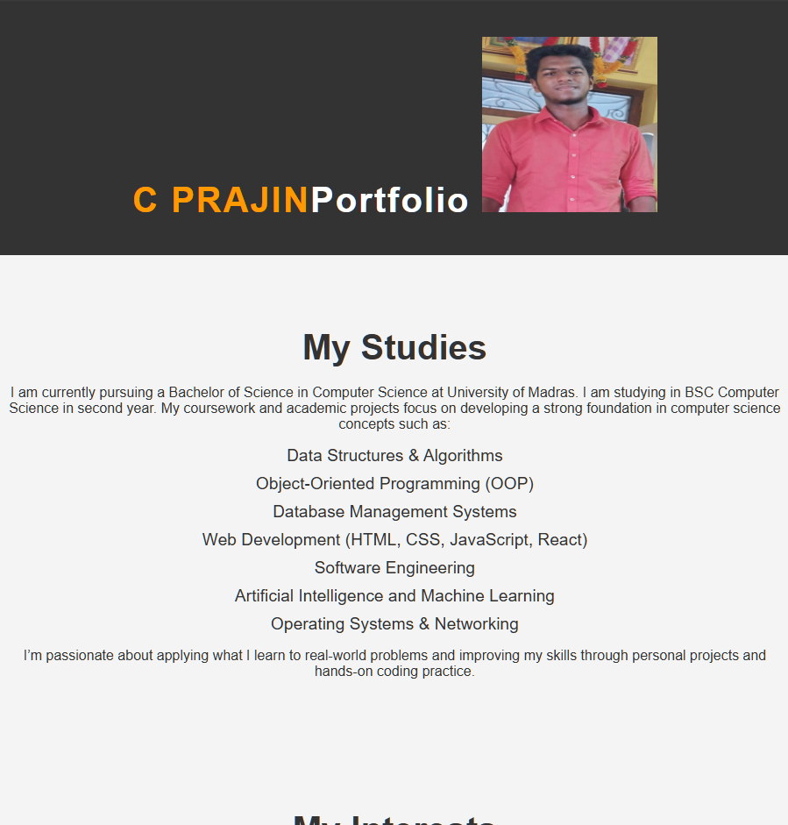

RESULTS AND SCREENSHOTS
3/21/2024 Annual Review
10

Slide 11
CONCLUSION
This project provided a strong foundation in front-end web development by focusing on the use of HTML for structuring content effectively. It demonstrated how semantic HTML can be combined with CSS and JavaScript to create a responsive, user-friendly, and visually appealing website. Through this project, I gained practical experience in building accessible web pages, organizing code efficiently, and deploying a functional website. Overall, the project successfully met its goals of presenting content clearly and providing a smooth user experience across devices.
11

